Slide 1

The Case for Higher Lift Ticket Prices at Big Mountain Resort
Composed by: Alex Blaies

Slide 2

Problem Statement
Objective:
Understand where Big Mountain currently fits into the ski resort market (is Big Mountain charging enough for the experience they provide? How can we improve the experience?)
Determine what opportunities exist to increase the top and bottom lines while improving the overall customer experience/perceived value of a lift ticket
Create a pragmatic roadmap to realize future opportunities
Criteria for Success:
Increase lift ticket sales by 12%
Increase business profitability by 3-4%
Is Big Mountain underselling themselves in relation to the market?

Slide 3
Problem Statement Continued
Scope of solution space
Conduct cost-benefit analyses for proposed capital investments that may lead to higher returns
Generate ideas to reduce waste/OPEX based on what the Customer considers to be “value-added”
Key data sources:
Comprehensive ski resort dataset comprising of many features (independent variables) that may or may not influence ticket price
State population data to create density/relational metrics
Is Big Mountain underselling themselves in relation to the market?

Slide 4
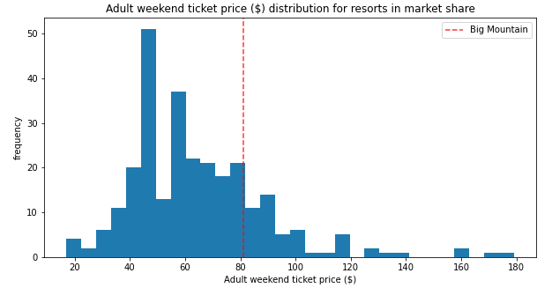
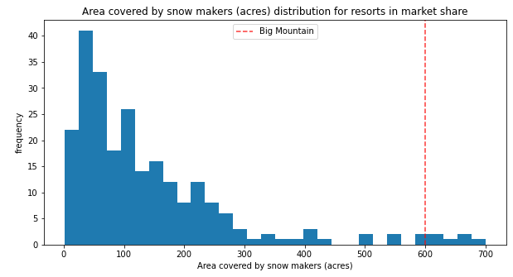
Key Findings
Current Market Position
What justifies the potential Premium?
Based on the predictive model, it appears that Big Mountain Resort is undercapitalizing the Business
Modeled ticket price based on current conditions = $95.87 +- $9.65
Current average rate = $81
What do Customers really care about?
Total runs, Snow Making Area, Vertical Drop, # of Fast Quads, Total Skiable Area, Longest Run Length
After analyzing the major variables, Big Mountain sits near the upper quartile for most (1 example shown below)

Slide 5
Recommendations
Review the current topographic landscape and popularity of available runs
Get feedback from Customers on which runs they enjoy the most as well as pain points
Discuss the viability of immediately increasing the ticket price by $5-10 to support proposed improvements
Socialize the improvement roadmap with the Customers
Finalize a price appreciation plan that coincides with the improvement roadmap to fully capitalize on market positioning

Slide 6

Modeling Results and Analysis
Understanding why and how…

Slide 7
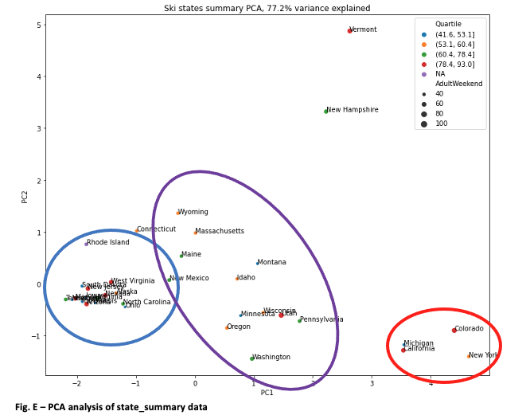
Preface on Modeling Results and Analysis
Key assumptions:
Prices are set by a free market dictated by consumer demand versus available supply (all domestic resorts)
Not accounting for annualized visitor data or operating costs
Not accounting for demographic and gross household income differences as it relates to states/regions
Is this analysis region-specific or all encompassing?
To determine this, we analyzed the state population to determine if certain states/regions should be characterized differently
Based on the PCA, we determined that it was best to consider all states/regions to be equal

Slide 8
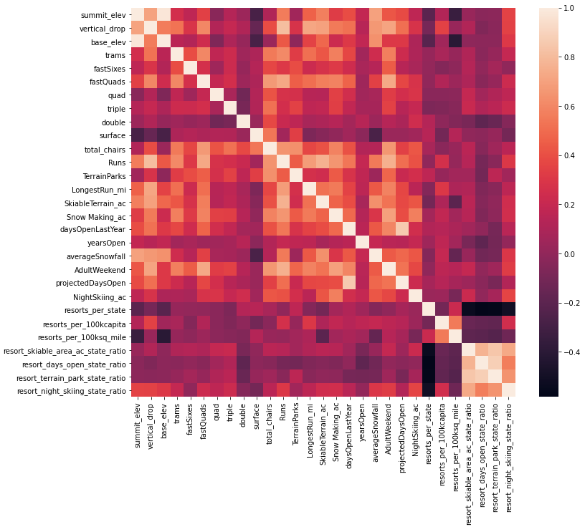
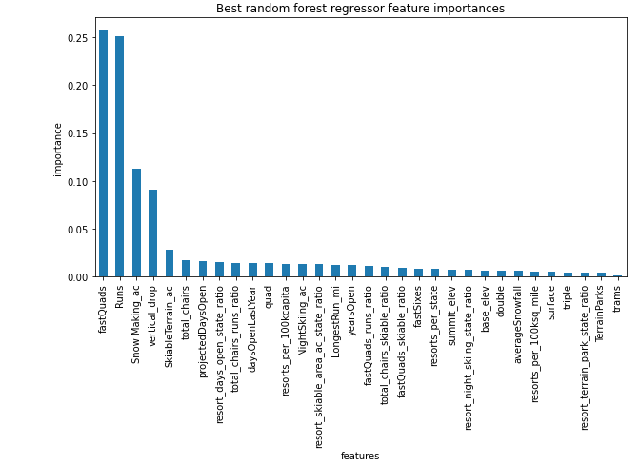
Modeling Results and Analysis
How did we determine what the major features were and Big Mountain’s current position?
Developed a correlation matrix to visualize magnitudes of influence for each feature
Created two models (simple linear regression and random forest)
Optimized the most accurate model (random forest)

Slide 9
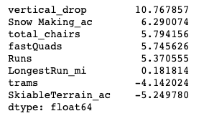
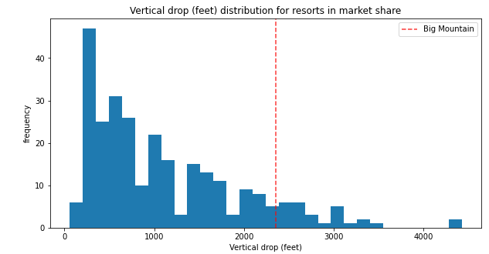
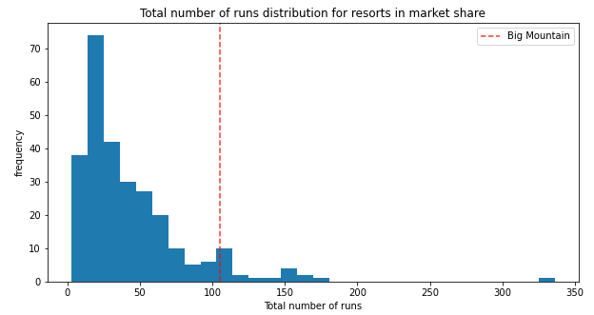
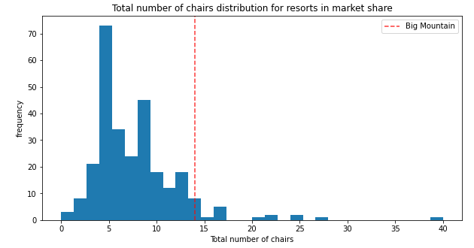
Modeling Results and Analysis Continued…
What features are most important from a quantitative perspective
How does Big Mountain fit in?

Slide 10
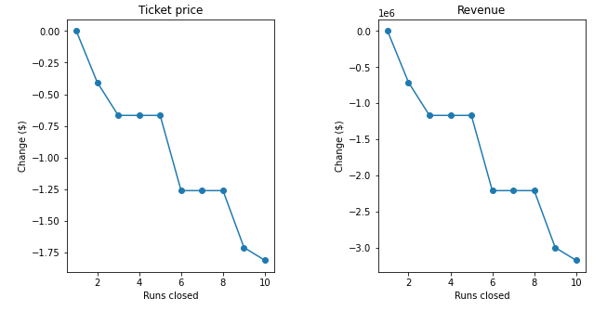
Modeling Results and Analysis Continued…
Modeling scenarios with subsequent results →
Scenario 1 – close up to 10 of the least popular runs
See diagrams
Scenario 2 - add a run + increase vertical drop by 150 ft + installation of new chair lift
Results from model yielded a ticket price increase of $1.99
Scenario 3 – replication of scenario 2 + adding 2 acres of snow
Results from model yielded a ticket price increase of $1.99
Scenario 4 - increasing the longest run by .2 miles + adding 4 acres of snow-making capability
Results from model yielded a ticket price increase of $0

Slide 11
Summary and Conclusion
Big Mountain is currently undercapitalizing their business and relative position in the marketplace (model calling for ~$96 per ticket)
Vertical drop, snow making capabilities, readily available transportation (lifts) and total amount of available runs influence the ski lift ticket price
Some potentially pertinent data was excluded from this analysis (gross household income/demographic data, annual visitors for each resort, operating parameters/costs)
The model is capable of modeling additional scenarios based on adjusting inputs
Leadership team should review their current pricing strategy and create an improvement roadmap to further enhance the customer experience (model can serve as guidance and justification)

Slide 12

Thank You

